Slide 1
Upton Municipal Airport
Master Plan
December 14, 2021

Slide 2
Airfield Classification Systems
Aircraft Approach Category (AAC)
AAC | Approach Speed (1.3 X Stall Speed)
A | Less than 91 knots.
B | 91 knots or more but less than 121 knots.
C | 121 knots or more but less than 141 knots.
D | 141 knots or more but less than 166 knots.
E | 166 knots or more.
Airplane Design Group (ADG)
ADG | Tail Height (ft.) | Wingspan (ft.)
I | <20’ | < 49’
II | 20’ - < 30’ | 49’ - < 79’
III | 30’ - < 45’ | 79’ - < 118’
IV | 45’ - < 60’ | 118’ - < 171’
V | 60’ - < 66’ | 171’ - < 214’
VI | 66’ - < 80’ | 214’ - < 262’
Aircraft Weight Classifications
Aircraft Classification | Maximum Takeoff Weight (MTOW) | Number of Engines | Wake Turbulence
A | < 12,500 lbs, | Single | Small (S)
B |  | Multi | Small (S)
C | 12,500-300,000 lbs. | Multi | Large (L)
D | >300,000 lbs | Multi | Heavy (H)

Slide 3
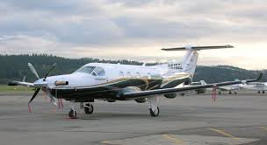
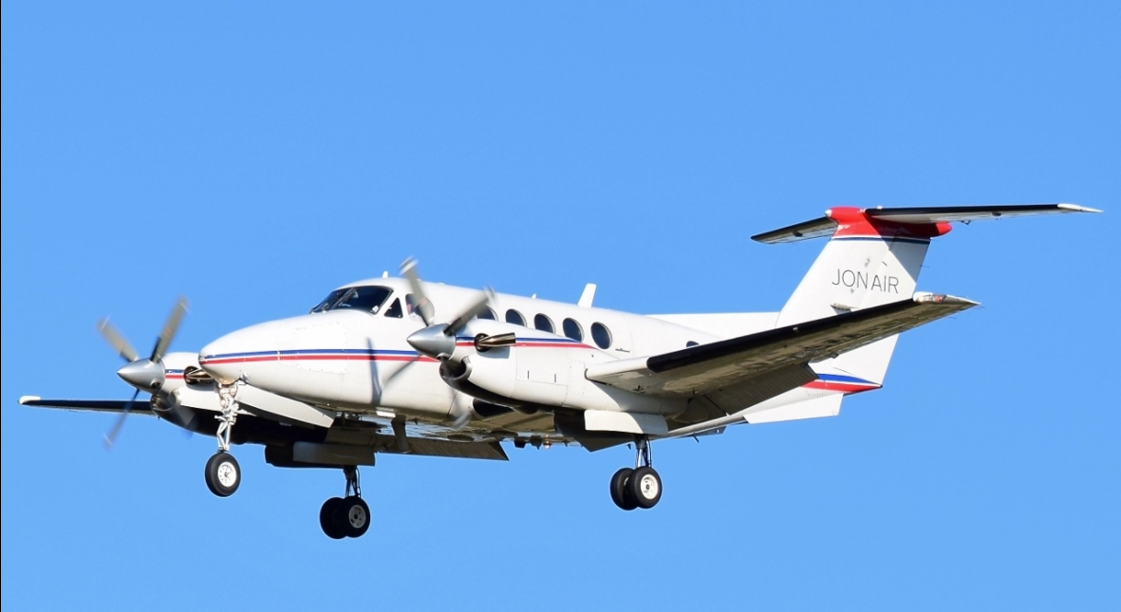
Facility Classification
A/B-II (Small)
Super King Air B-200
Pilatus PC-12

Slide 4
FAA Design Standards
 |  |  | FAA Standards for A/B-II
Runway Object Free Area
Width |  |  | 500’
Length Beyond Runway End |  |  | 300
Runway Safety Area
Width |  |  | 150’
Length Beyond Runway End |  |  | 300

Slide 5
FAR Part 77
Surfaces

Slide 6
Key Facilities:
FBO Hangar and Facilities (Pilot Lounge, Public Restroom)
Apron w. Tie-downs
Aircraft Storage Hangars
Access and Vehicle Parking
Fuel Storage

Slide 7
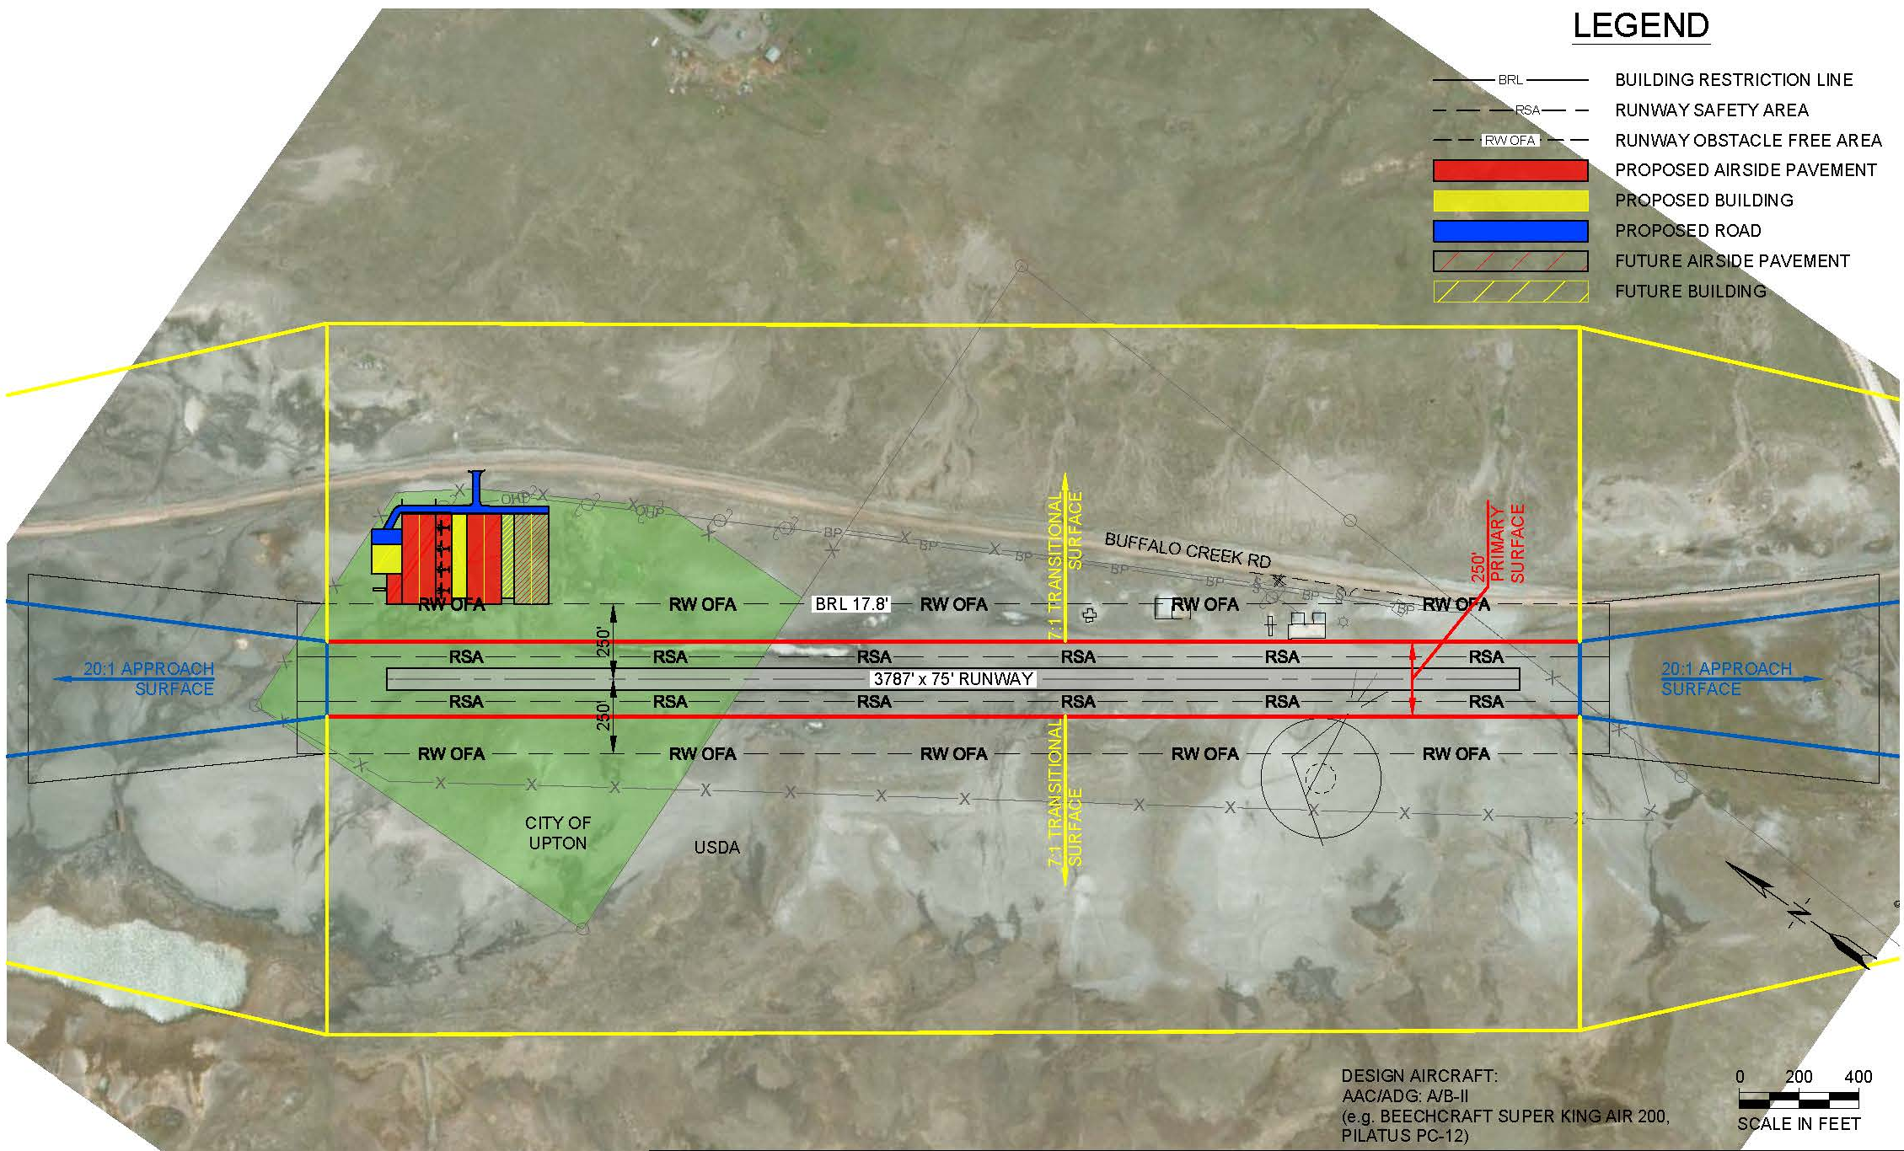
Airside Alternative #1

Slide 8
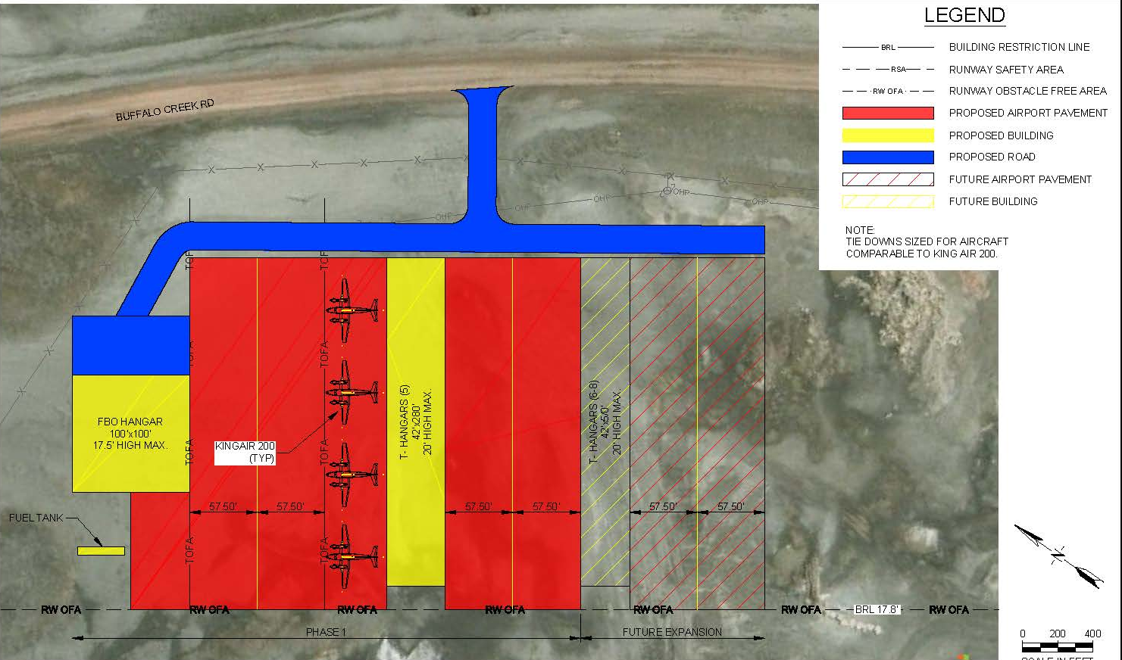
Landside Alternative #1

Slide 9
Airside Alternative #2

Slide 10
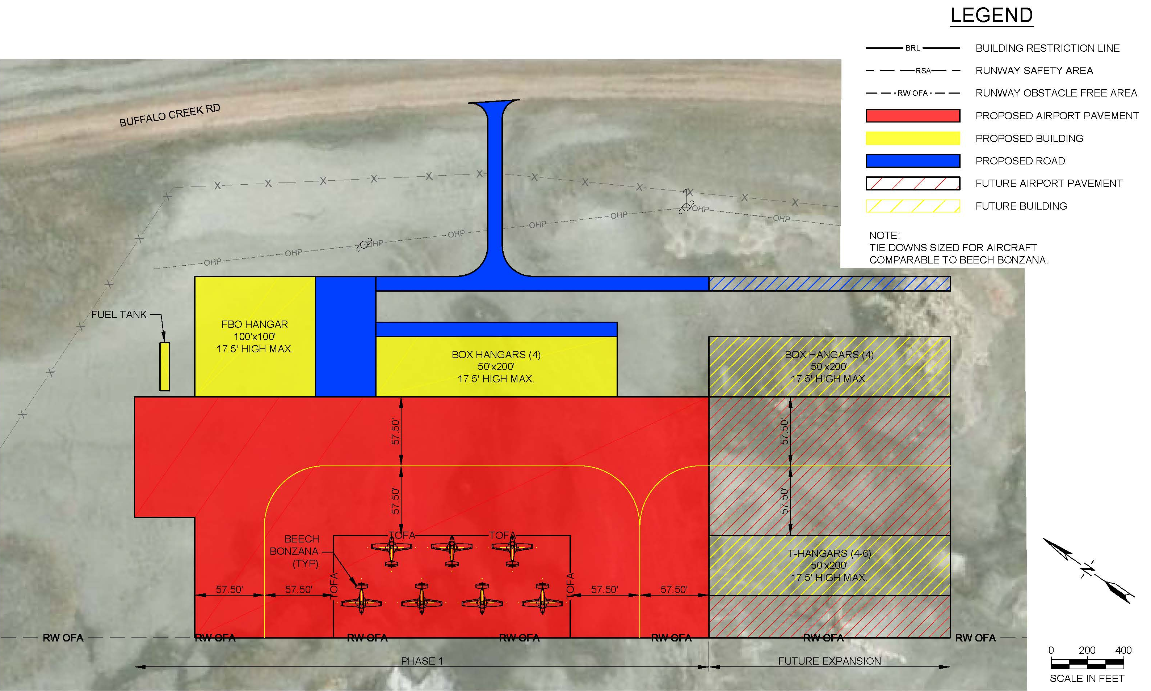
Landside Alternative #2

Slide 11
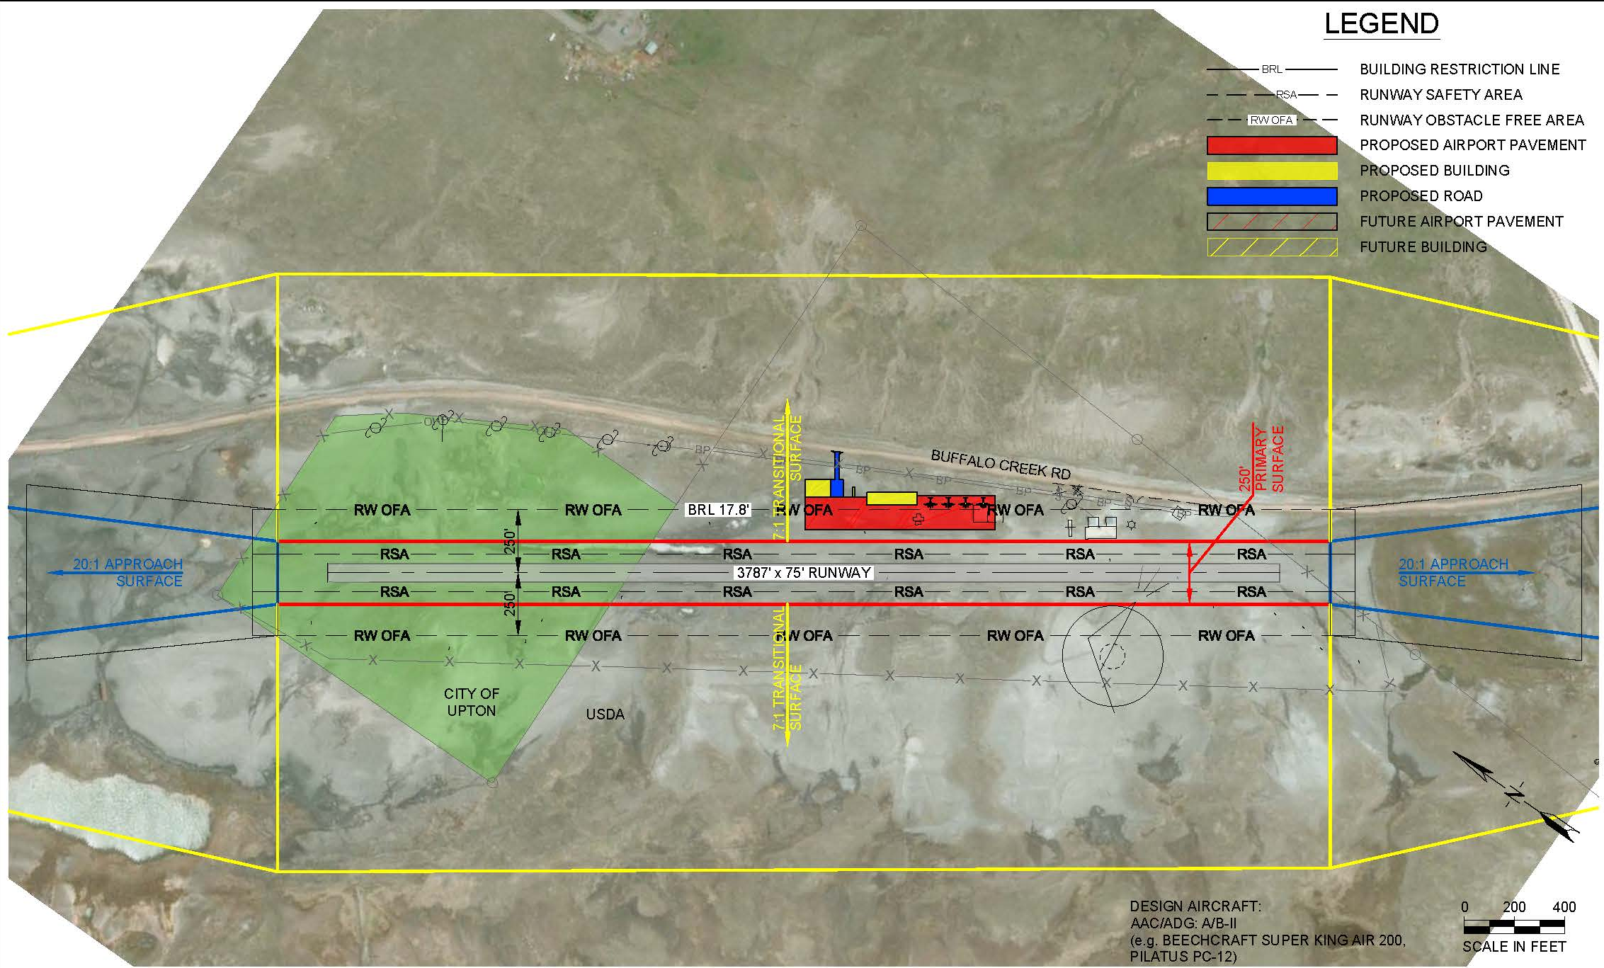
Airside Alternative #3

Slide 12
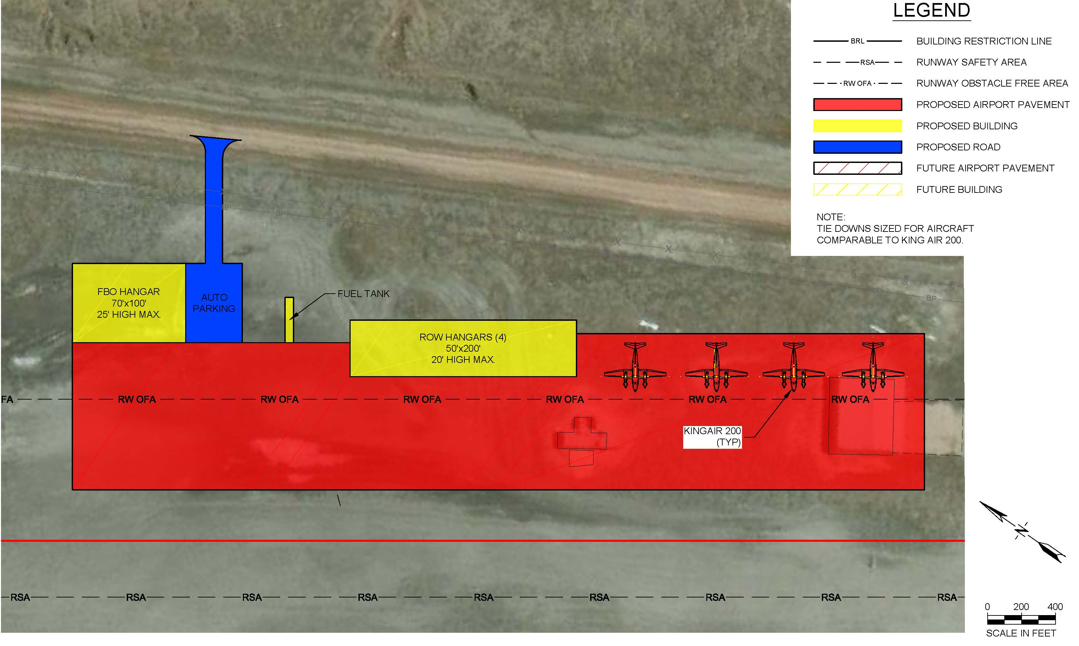
Landside Alternative #3

